Slide 1


FDIR
Spacecraft fault protection system
Project 2
Final presentation
Architectural Design
Euro Team
Alauzet Pierre, Ahvenniemi Mikko,
Colin Julien, Starck Benoit
CS554 - Design for Software & Systems

Slide 2
Table of Contents
Context & business case
ATAM approach in the architecture building
Architectural decisions & design
Architectural analysis

Slide 3
1. Context & business cases
Business drivers, context
Business drivers, requirements

Slide 4
1. Business drivers - context
1. Context & business case
2. ATAM approach
3. Architectural design
4. Architectural analysis
Client : NASA
Users : Spaceship crew and flight control can manually control the system
The problem : Fault detection
  Detected when monitored values are out-of-tolerance
The solution : Fault protection system (FDIR)
  Act when the spacecraft is going through an error or a fault
  FDIR is a layered system. If a lower layer cannot resolve an issue it’s forwarded to an upper layer. If the Issue cannot be resolved by the system. It’s escalated to manual control.
  Automatic system

Slide 5
2. Business Drivers - requirements
1. Context & business case
2. ATAM approach
3. Architectural design
4. Architectural analysis
Clients global needs :
  Guarantee the completion of any time critical activities of the spaceship
  Keep the control of the spacecraft with safety, observability & commandability
Main qualities attributes :
  Reliability : The system must be reliable in all operating conditions.
  Availability : The system must not lock or stall when processing data. It must work asynchronously and must be available all the time.
  Adaptability : FDIR has to be adaptable for manned and unmanned spacecraft.

Slide 6
2. ATAM approach in
the architecture building
ATAM assessment steps
Utility tree
Utility scenario
Overall architecture
Architectural approach

Slide 7
1. Atam assessment steps
1. Context & business case
2. ATAM approach
3. Architectural design
4. Architectural analysis
1
2
Present FDIR business drivers
3
Present FDIR architecture made through ACME
4
5
6
7
8
9
Identify FDIR architectural approaches made through ACME
Generate FDIR quality attribute utility tree
Analyze architectural FDIR approaches made through ACME
Brainstorm and prioritize scenarios of FDIR requirement
Analyze FDIR architectural approaches made through ACME
Present FDIR ATAM assessment results
Present the ATAM

Slide 8
2. Utility tree
1. Context & business case
2. ATAM approach
3. Architectural design
4. Architectural analysis
Utility
Availability
Security
Data integrity
Performance
Modifiability
Configurability
Throughput
Hardware failure
Latency
Usability
Recoverability
Learn ability
Consistency
Testability
(H, M) The system and its parts have to be able to be tested through inspections, simulations and analyses
(H, M) FDIR must have a data backup system in case of hardware failure.
(H, M) The system must use an asynchronous mode of operation
(M, H) The system must respond to input within 2sec
(M, L) If the system load doubles from normal response time has to stay within 3 seconds.
(M, M) The system must recover from failures in parts of the system in 1 minute
(M, M) The system must be reliable in all operating conditions.
(L, M) System must provide easy-to-learn features
(L, M) The FDIR interface should provide several views with consistent conventions
(M, L) No operation should be irreversible, and confirmation should be asked to user each time
(M, M) The system has to be configurable to other spacecrafts in 1 person year of work

Slide 9
3. Utility Scenarios
1. Context & business case
2. ATAM approach
3. Architectural design
4. Architectural analysis
Use case scenarios
  No operation should be irreversible, and confirmation should be asked to user each time
  The FDIR interface should provide several views with consistent conventions
Growth scenarios
  A new sub-system must be able to be installed in to the FDIR in 1 person day of work
Exploratory scenarios
  If the system load doubles from normal response time has to stay within 3 seconds.
  The system has to be configurable to other spacecrafts in 1 person year of work

Slide 10
4. Overall architecture
1. Context & business case
2. ATAM approach
3. Architectural design
4. Architectural analysis
Control
Reporting system
FDIR control system
Localization
System call
Information displayer
Localization
FDIR fault analyzer
Information
retrieval
Values
Sorted values
FDIR fault detector
FDIR data storage system
Sorted values
Information
retrieval
Values
System recovery
Monitored systems
Legend :
Data flow
FDIR subsystems
Control flow
Spacecraft systems

Slide 11
4. Overall architecture (cont.)
1. Context & business case
2. ATAM approach
3. Architectural design
4. Architectural analysis
Manual FDIR
Automatical
Control
Information displayer
FDIR fault analyzer + control system
System control
Legend :
Subsystem
FDIR systems
Control
Localization
Device functions
Fault analyzer system
(5 layers)
Data storage system
Localization
Individual device
Report
Fault detector system
Values
System
recovery
Spacecraft
systems
Sorted values
Fault filtering system
Monitored system
FDIR fault
detector
Monitored value checker
Data flow
Information retrieval
Control flow
Values

Slide 12
5. Architectural approach
1. Context & business case
2. ATAM approach
3. Architectural design
4. Architectural analysis
Event driven architecture
  Devices subscribe to sub-systems which in turn listen to events broadcasted by the devices.
  Such events can be for example “announce value” event
  Choice based on identified quality attributes
    Enables asynchronous processing
    High potential for resilience in case of failure
    Load can be balanced efficiently between systems
  Architectural approach follows logically from system architecture

Slide 13
3. Architectural
decisions & design
ADL choice and background
Critical architectural decisions
Architectural design propositions
Architecture

Slide 14

1. ADL investigation and choice
1. Context & business case
2. ATAM approach
3. Architectural design
4. Architectural analysis
We have chosen ACME !
Well known
Well documented
Good tools support
  Complete and well-made software as an Eclipse plug-in
  Free software available on every platforms
Developed in the same university as ATAM method – Carneggie Melon University
Provide a generic, extensible infrastructure for describing, representing, generating, and analyzing software architecture language description.
Provide descriptions that are easy to understand for everyone

Slide 15
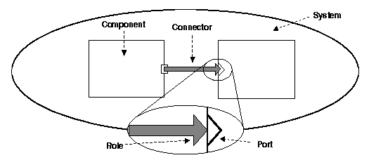
1. Acme reminder
1. Context & business case
2. ATAM approach
3. Architectural design
4. Architectural analysis
ACME describes a whole system thanks to
  Library of 7 architectural elements
    Components
    Connectors
    Systems
    Ports
    Roles
    Representations
    Representation maps
  Architectural families
    Tiered
    Pipe & filters
    Client & servers
    Pub-Sub
    Shared data
    Three-tiered

Slide 16
2. Critical architectural decisions
1. Context & business case
2. ATAM approach
3. Architectural design
4. Architectural analysis
Architectural approach
  Enables asynchronous processing
  High potential for resilience in case of failure
  Load can be balanced efficiently between systems
Utility tree
  Availability
  Reliability
  Recoverability
Scenarios
  Use case scenarios: user action should be done at any moment
  Exploratory scenario: if a FDIR sub-system is crashing, FDIR should still work

Slide 17
3. Architectural design proposition (cont.)
1. Context & business case
2. ATAM approach
3. Architectural design
4. Architectural analysis
Architectural context
  Centralized system
  Distributed system
Producer
Broker
Consumer
Producer
Consumer

Slide 18
3. Architectural design proposition (cont.)
1. Context & business case
2. ATAM approach
3. Architectural design
4. Architectural analysis
Architectural types: available families in ACME Studio are
  Tiered
  Pipe & filters
  Client & servers
  Shared data
  Three-tiered
  Pub-Sub
    Event based architecture where publishers and subscribers don’t know each others.
        publishers notifies subscribers about news
        subscribers are submitting their interest in particular news
    This architectural style is :
        space-decoupled : the event service links publishers and subscribers that don’t know each others
        time-decoupled : publishers can send notifications while subscribers are not running and vice versa
        synchronization-decoupled : concurrent activities can be performed by publishers and subscribers

Slide 19
3. Architectural design proposition (cont.)
1. Context & business case
2. ATAM approach
3. Architectural design
4. Architectural analysis
Pub-sub (Publish /Subscribes)
  Content based
    Subscription system based on a defined type of content
    Subscribers declare the types of event they are interested to, by using filters
    Possible to define combination of several types, but complex protocol
  Topic based
    Bundle communication peers, with methods to characterize & classify event content (divided by keys in a string shape).
    Each topic is linked to an individual communication channel
    Every topic is a static and primitive kind of event that a subscriber subscribes to

Slide 20
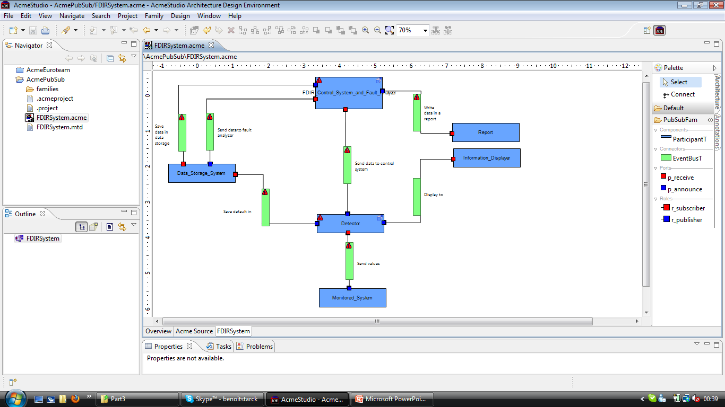
4. Architectural design using acme Studio
1. Context & business case
2. ATAM approach
3. Architectural design
4. Architectural analysis

Slide 21
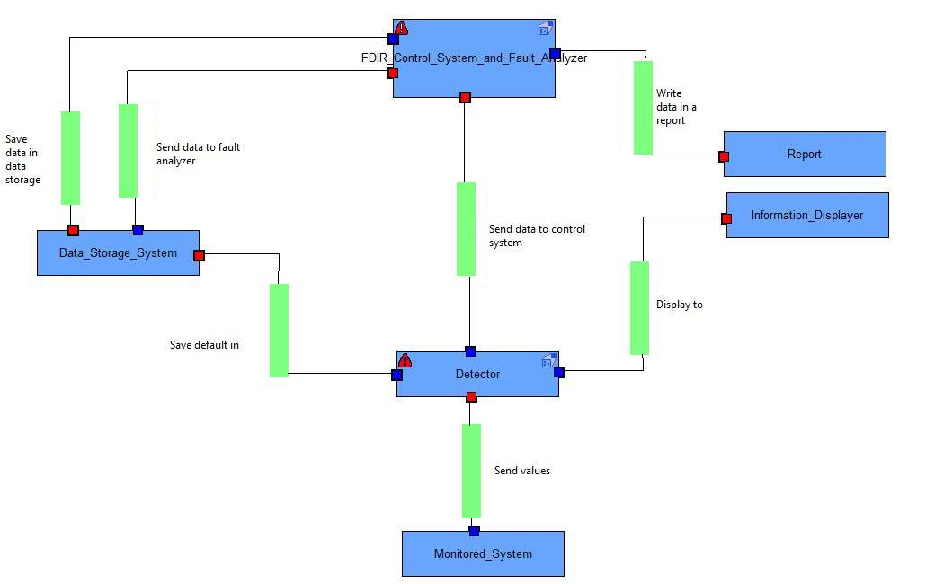
4. Architecture : FDIR SYSTEM representation
1. Context & business case
2. ATAM approach
3. Architectural design
4. Architectural analysis

Slide 22
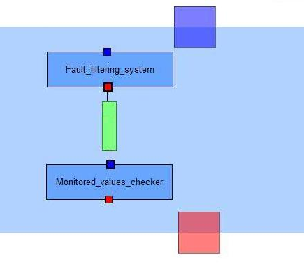
Architecture : Fault detector representation
1. Context & business case
2. ATAM approach
3. Architectural design
4. Architectural analysis

Slide 23
4. Architecture : FDIR SYSTEM representation
1. Context & business case
2. ATAM approach
3. Architectural design
4. Architectural analysis

Slide 24
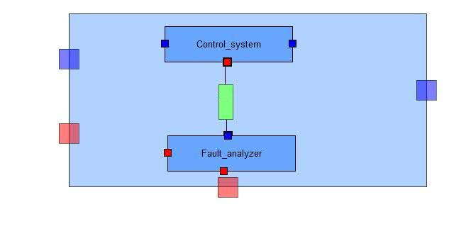
4. Architecture : Control system & fault analyzer
1. Context & business case
2. ATAM approach
3. Architectural design
4. Architectural analysis

Slide 25
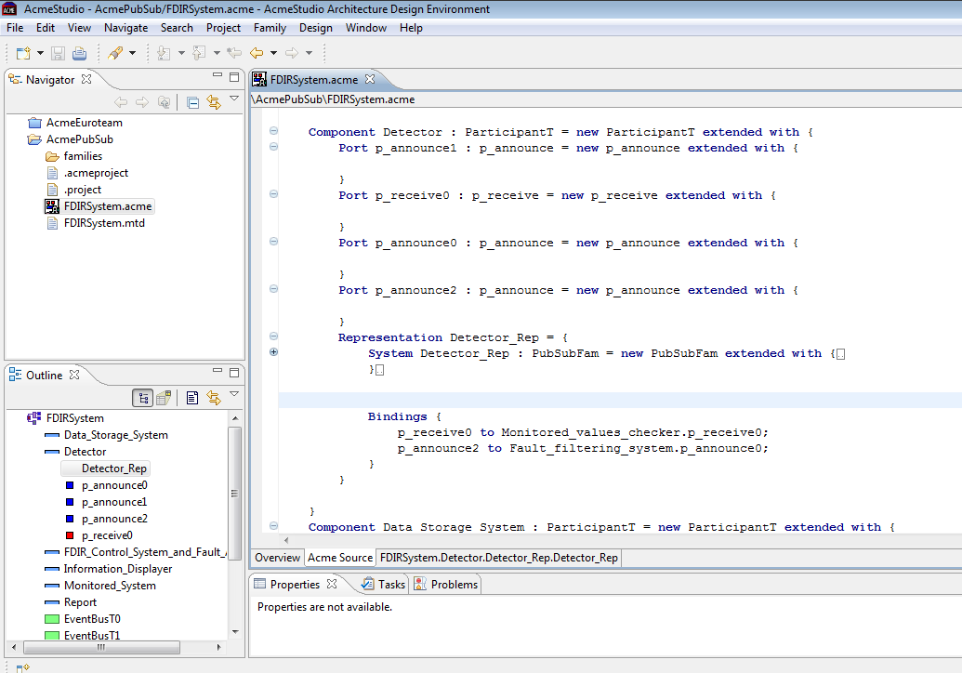
4. Architecture : code sample
1. Context & business case
2. ATAM approach
3. Architectural design
4. Architectural analysis

Slide 26
4. Architectural analysis
Requirements compliance
Architectural design strengths & weaknesses
Architectural type comparisons
Architectural approach analysis
Sensitivity points, risks, tradeoffs

Slide 27
1. FDIR & ADL Requirements compliance
1. Context & business case
2. ATAM approach
3. Architectural design
4. Architectural analysis
Thanks to Publish/Subscribe pattern
  FDIR is a monitoring system involving several interaction between several components
    Event-based architecture
  Publish/Suscribe architectural style meet the need of asynchronous communication
  The topic-based aspect allows us to focus on a limited number of kind of event
    Control operation
    Monitored values
    Analysis results
    Reports
    Etc.
  Publish and suscribe family is ready-to-be-used within ACME Studio tool

Slide 28
1. FDIR & ADL Requirements compliance (cont.)
1. Context & business case
2. ATAM approach
3. Architectural design
4. Architectural analysis
FDIR system organization
  The layered fault analyzer and control system are better defined using a waterfall of publishers/subscribers
  ACME studio allows us to clearly divide our architecture as we did with the overall model using representations
Utility tree
  Availability & reliability are reached thanks to the loosed-coupling components in publish/subscribe architectural style
  Recoverability is respected thanks to the independence of entities (publishers & subscribers) that can recover from failure while FDIR global system is still working

Slide 29
2. Architectural design strengths
1. Context & business case
2. ATAM approach
3. Architectural design
4. Architectural analysis
Loosely coupled
  Publishers and Subscribers need not know of each other’s existence
  They can also ignore system topology
  Decoupling doesn’t work only location wise, but also temporally
    Taking publishers down allows subscriber work through backlog for example
Scalable
  Provides better scalability then client-server architecture in smaller installations
    Parallel operation, message caching, tree-based or network-based routing

Slide 30
2. Architectural design weaknesses
1. Context & business case
2. ATAM approach
3. Architectural design
4. Architectural analysis
Disadvantages also stem from decoupling of publishers from subscribers
  Stronger guarantees cannot be given that messages would always be delivered
  Another problem can arise if publishers assume that subscribers are listening. For example if error messages are logged by the subscriber and the subscriber crashes message from the publishers will be lost
The technology scales poorly when systems become extensively large
  Could manifest in instabilities in throughput, or slowdowns

Slide 31
2. Architectural design WEAKNESSES (CONT.)
1. Context & business case
2. ATAM approach
3. Architectural design
4. Architectural analysis
In-band message broadcasting can lead to security problems
  Brokers might be fooled into sending notifications to the wrong client leading to potential DoS attacks
  Brokers could be overloaded as well
  Subscriber might be able to receive data that is is not authorized to receive.
  An unauthorized publisher may be able to introduce incorrect or damaging messages into the system

Slide 32
3. Architectural type comparisons
1. Context & business case
2. ATAM approach
3. Architectural design
4. Architectural analysis
Architectural style | Scalability | Availability | Security | Maintenance
Pub-Sub | Good in the small | Good, because of decoupling | Potentially compromised because of decoupling | Possible complex due to distributed nature
Client-Server | Good in the large | Potentially compromised because of single point of failure | Strong because of central control | Usually simple because of centralized control

Slide 33
4. Architectural approach analysis
1. Context & business case
2. ATAM approach
3. Architectural design
4. Architectural analysis
Scenario | S1 (Maintain operation despite sub-system failure)
Attribute | Availability
Environment | Normal operation
Stimulus | Sub-system failure
Response | Availability of rest of the system
Architectural decisions | Risk | Sensitivity | Tradeoff
Pub-Sub architecture | R2 | S3 | T1
Backup sub-systems | R3 | S2
No backup data channel | R4 | S4 | T3
Reasoning
Pub-sub architecture achieves availability by providing possibility for additional subscribers (S3)
Publishers only send messages to the event bus and are not directly connected to subscribers
Backup system can be available reasonably fast considering (S2)

Slide 34
5. Risks
1. Context & business case
2. ATAM approach
3. Architectural design
4. Architectural analysis
Risk | Description
R2 | Pub-Sub architecture contains the event bus. Availability may be compromised if the bus clogs down and messages won’t get through. This will happen If there is a swarm of messages that cannot be handled fast enough.
R3 | If backup system has inconsistent data with the actual system, availability of the system might be compromised. This will happen when messages in queue are not delivered to recipients.
R4 | There is only one data channel. If there is a malfunction in the channel, the availability of the system is compromised. This happens for example if the physical data cable breaks down.

Slide 35
5. Sensitivity points
1. Context & business case
2. ATAM approach
3. Architectural design
4. Architectural analysis
Sensitivity Point | Description
S2 | Response time of the backup system is sensitive to the readiness of backup system. Options are for example it can be turned off, turned on, or even turned on and actively synchronized
S3 | The latency for handling messages is sensitive to the ratio between publishers and subscribers. If there are too many publishers per subscriber latency will increase.
S4 | Performance of the system is sensitive to the bandwidth of the data channel.

Slide 36
5. tradeoff points
1. Context & business case
2. ATAM approach
3. Architectural design
4. Architectural analysis
Tradeoff Point | Description
T1 | Pub-Sub architecture scales really well in smaller installations, but if the system becomes too large the large number of messages starts to clog down the system
T3 | Using one data channel is good for performance of the system, but on the other hand it makes to system possibly vulnerable in regards to availability if there is a malfunction in the data channel

Slide 37
Conclusion
General learning points and architectural results
  Be able to justify architectural key decisions and propositions
  Explain and represent an architecture using rules and tools
  Analyze and criticize an architecture
  Propose alternatives to given architecture
  Provide the output of architectural analysis facilitate communicating the architectural design to stakeholders
Technical learning points
  Refer to ATAM process
  Use ADL methods
  Manage ACME ADL and Acme Studio tool

Slide 38
FDIR
Spacecraft fault protection system
Project 2
Final presentation
Architectural Design
Euro Team
Alauzet Pierre, Ahvenniemi Mikko,
Colin Julien, Starck Benoit
CS554 - Design for Software & Systems

Slide 39
references
[BCK98] L. Bass, P. Clements, R. Kazman, Software Architecture in Practice (2nd ed.), Addison-Wesley, 2003.
[Eas98] Steve Easterbrook, and et al., “Experiences Using Lightweight Formal Methods for Requirements Modeling,” IEEE Transactions on Software Engineering, Vol. 24, No. 1, January 1998.
[KKC00] R. Kazman, M. Klein, P. Clements, ATAM: A Method for Architecture Evaluation, CMU/SEI-2000-TR-004, Software Engineering Institute, Carnegie Mellon University, 2000.
[SG96] M. Shaw and D. Garlan, Software Architectures – Perspectives on an Emerging Discipline, Prentice Hall, 1996.
P. T. Eugster, P. A. Felber, R. Guerraoui and A. M. Kermarrec, The Many Faces of Publish/Subscribe, in ACM Computing Surveys, vol. 35, no. 2, June 2003, pp. 114-131

